Slide 1


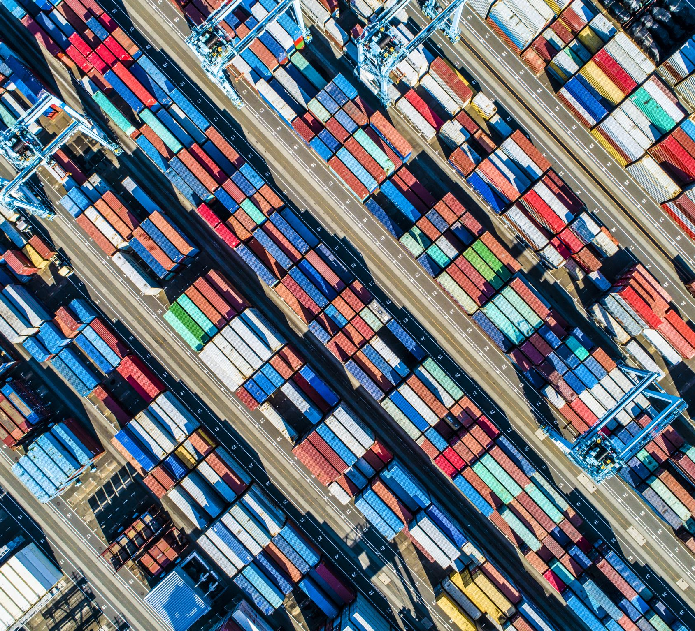
Containers and Orchestration
Fundamental Concepts of Containers and Orchestration
Prepared By Enes Erten

Slide 2
Contents
The Basics and Concepts
1. What are containers?
2. What is container orchestration?
3. What are containers used for?
4. Advantages and Limitations of Containers

Slide 3
Contents
Container and Orchestration Technologies
1. Docker 9. RedHat OpenShift
2. Kubernetes
3. Marathon
4. Nomad
5. Amazon ECS for Kubernetes
6. Google Kubernetes Service
7. Azure Kubernetes Service
8. IBM Kubernetes Engine

Slide 4
Contents
Use cases
1. Microservices
2.Cloud Transformation
3. Automated Scaling
4. Continuous Deployment Pipelines
5. Self-Healing Applications
6. Developer Visibility
7. Multiple-Region Deployments

Slide 5
Content
Advanced Topics
1. Docker and Kubernetes
2. Deployment on Multiple region
3. Real Life Example

Slide 6
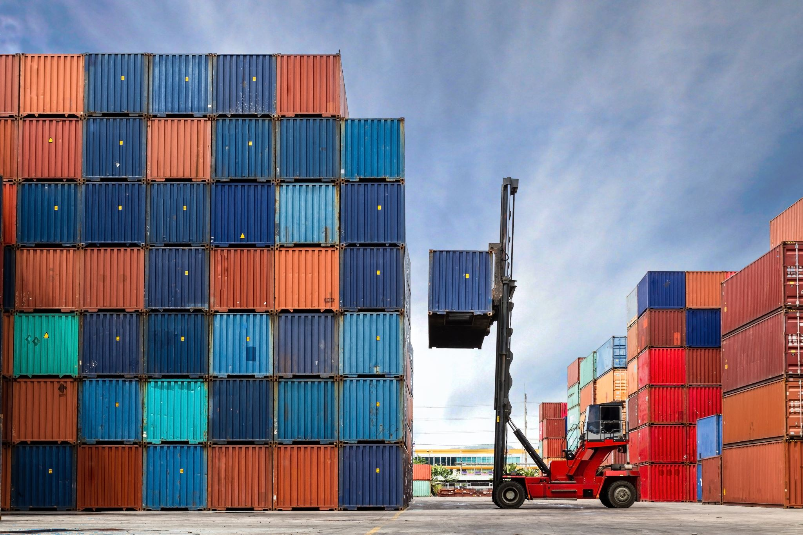
What are Containers ?
Containers are all about portable software
They are a technology that allowing to run software on a variety of systems reliability
Basically, it is a development, test, production system that the software to run reliably and consistently

Slide 7
What are Containers
Nowadays, most projects run on multiple different systems, devices with different operating systems at different places this makes everything complicated.
The solution for this is using container orchestration concept.
Container orchestration ensures run software on a portable fashion on multiple kinds of systems, these speeds up development, automatization, and most important thing run software reliably and consistently anywhere else.

Slide 8
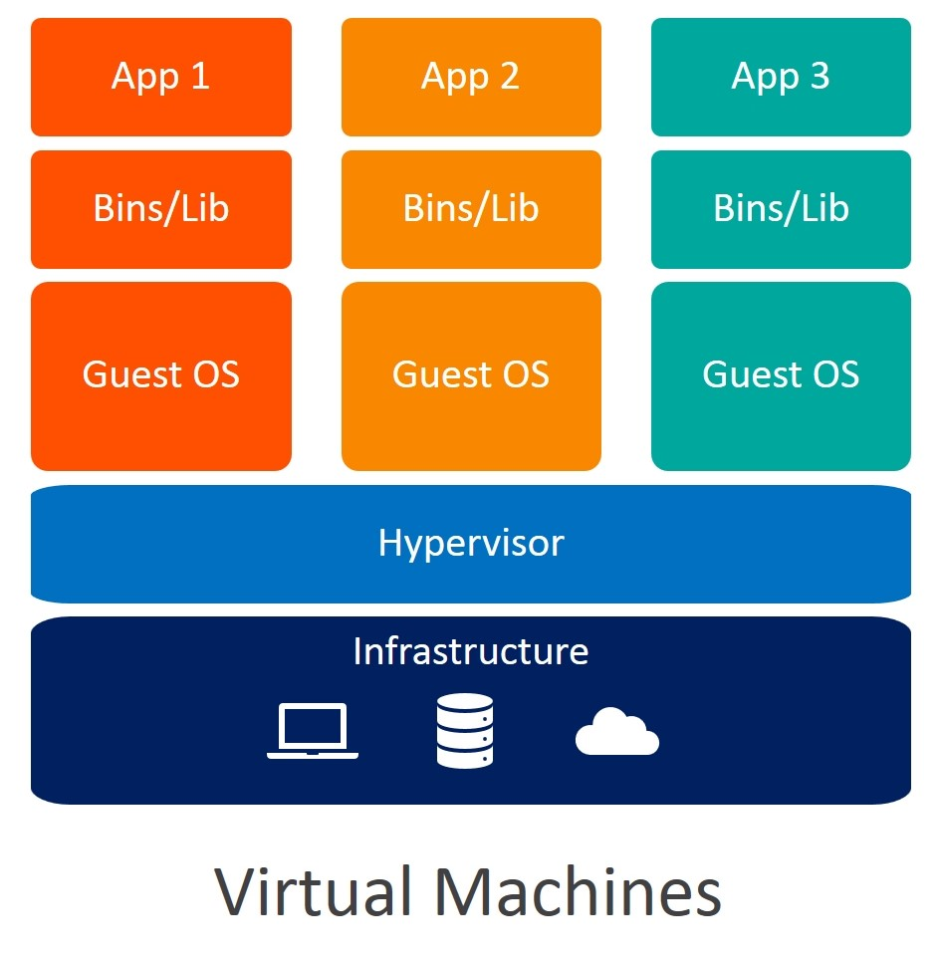
What are Containers ?
Virtual Machine (VM) is the virtualization/emulation of a computer system. Virtual machines are based on computer architecture and provide functionality of a physical computer. Their implementations may involve specialized hardware, software, or a combination.

Slide 9
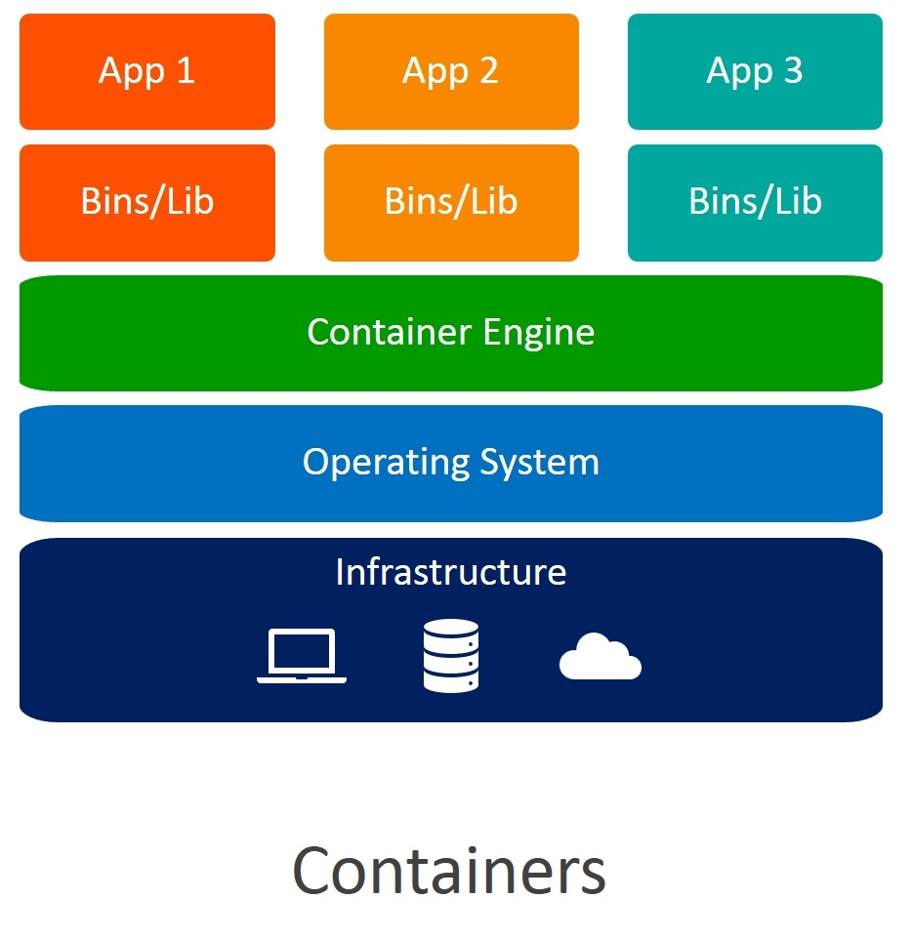
What are Containers ?
Containers are very similar to virtual machines in terms of the kind of benefits that they provide.
However, Containers working principle is slightly different way than the VM.
Containers are smaller than virtual machines
Uses fewer resources than VM
The most important different is easier automatization than VM

Slide 10
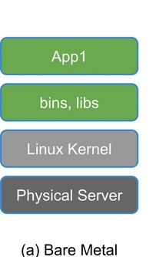
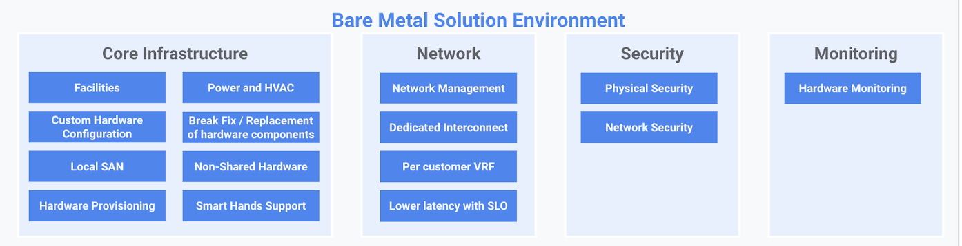
What are Containers ?
Scenario 1 Bare Metal Application
There is a host server and software installed in the server
Running the software needs lots of configurations and installations if the software need to install a new system these all configurations and installations must be exactly same with the first machine. In other words, all your new machine must be customized and configured same as host server.
There is lots of complexity and workload for every new installation.

Slide 11
What are Containers ?
Scenario 2 Virtual Machines
Virtual machines solve this problem by wrapping the software in a virtual machine
There is a host server and virtual machines installed essentially act as a virtual servers for the software to run on and that not required to configure the host server.
Only the virtual machine needs to be able to accommodate the software
Still similar complexity and workload exist with slightly decrease with 1st scenario.

Slide 12
What are Containers?
Scenario 3 Containers
Like the 2nd scenario containers do the same thing.
They sort of wrap tightly around the container orchestration tool.
There is less overhead in order to accommodate the software
These are reduction overhead
Fit more containers on a single host server of a smaller size compared to the 1st and 2nd scenarios
These makes containers smaller size and faster computation than other scenarios.
It is less complex and need less workload

Slide 13
What is Container Orchestration ?
Container orchestration refers to processes and tools that are used to manage containers, as well as automate the management of containers.
For instance:
Starting up a set of five containers in production
Without orchestration each container must be start up manually
Instead of that scenario using orchestration tool like Kubernetes, Docker etc. to start up 5 container.
Sake up redundancy, It is a good idea to spin up the five containers on five different hosts

Slide 14
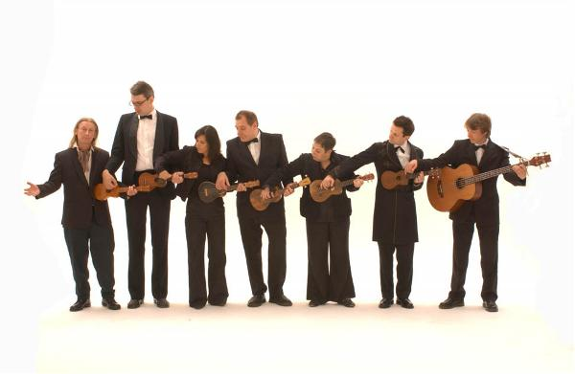
What is Container Orchestration ?
Traditional procedure to deployments
Take the server down for maintenance it will be unavailable for the clients
Perform the deployments
Bring the server back up.
New deployment is ready for the clients

Slide 15
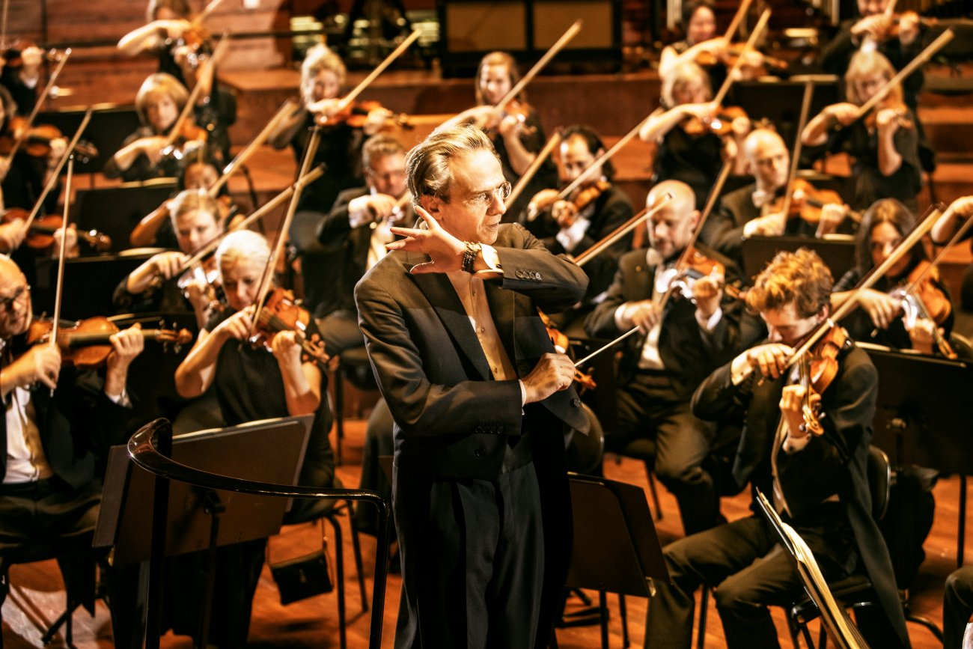
What is Container Orchestration ?
Deployment with Container Orchestration
Spin up containers running the new code
When they are fully up, direct client's traffic to the new containers
Remove the old containers running old code
No down time for clients
That process done by the Orchestration tools.

Slide 16
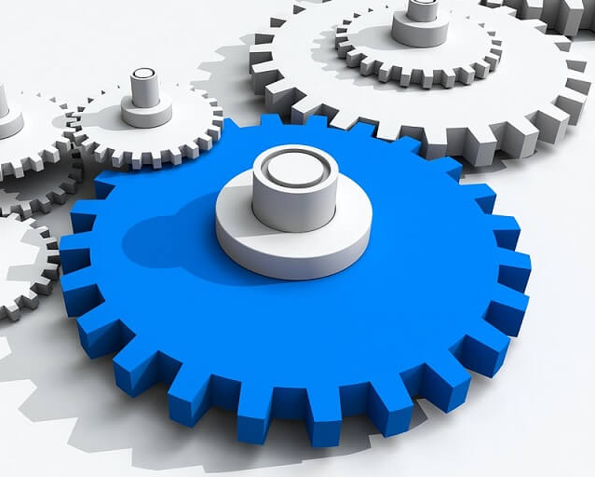

What are containers used for?
Software compatibility – Running software consistently on different machines
Isolation – Keeping individual pieces of software separate from one another
Scaling – Increasing or decreasing resources allocated to software as needed
Automation – Automating processes to save money and time
Efficiency – Containers use resources efficiently

Slide 17

Advantages and Limitations of Containers
Advantages
The isolation and portability
More lightweight than VMs less resource usage
Faster than VMs Containers can start up and down up in seconds
Smaller than VMs Containers images mostly measured in megabytes
All these advantages add up to faster and simpler automation

Slide 18

Advantages and Limitations of Containers
Limitations
Less flexibility than VMs
Can not run Windows container on a Linux machine (yet)
Introduces new challenges around orchestration and automation
The following article explains well challenges
https://www.techtarget.com/searchitoperations/tip/How-to-tackle-container-orchestration-challenges
https://www.dynatrace.com/news/blog/kubernetes-vs-docker/

Slide 19
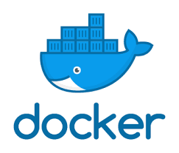
Container and Orchestration Technologies
Docker
Docker is primarily a container runtime
Furthermore, Docker is a piece of software that is designed to implement and support containers
Docker allows run containers on systems
Also, offers variety of tools for creating and managing containers and containers images
Currently, one of the industry leaders in container runtime
For more details, please check out the official site and documents
- Docker Build
- Docker Hub
- Docker Engine
- Docker Swarm
https://www.docker.com/

Slide 20
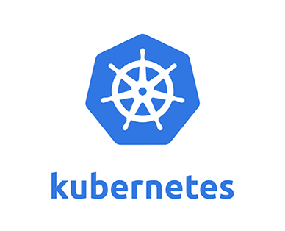
Container and Orchestration Technologies
Kubernetes
Kubernetes is a container orchestration tool.
It allows to easily build and manage your container infrastructure and automation
Preferred self-healing applications, automated scaling, and easy automated deployments
For detailed information check official site
- kubectl
- Kubeadm
- kubelet
https://kubernetes.io/

Slide 21
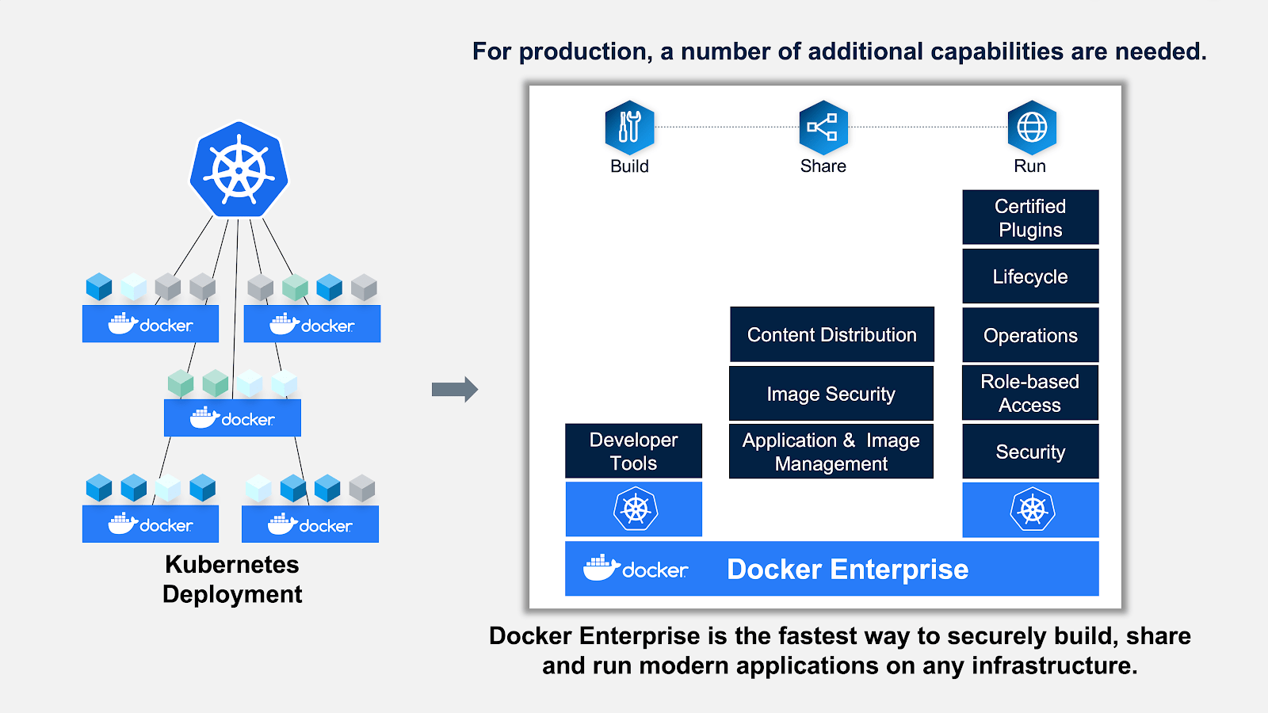
Container and Orchestration Technologies
Docker and Kubernetes

Slide 22
Container and Orchestration Technologies
Docker and Kubernetes
Simply put, the Docker suite and Kubernetes are technologies with different scopes. You can use Docker without Kubernetes and vice versa, however they work well together.
From the perspective of a software development cycle, Docker’s home turf is development. This includes configuring, building, and distributing containers using CI/CD pipelines and DockerHub as an image registry. On the other hand, Kubernetes shines in operations, allowing you to use your existing Docker containers while tackling the complexities of deployment, networking, scaling, and monitoring.
Although Docker Swarm is an alternative in this domain, Kubernetes is the best choice when it comes to orchestrating large distributed applications with hundreds of connected microservices including databases, secrets and external dependencies.

Slide 23

Container and Orchestration Technologies
Marathon
Marathon is a production-grade container orchestration platform for Mesosphere’s Datacenter OS (DC/OS) and Apache Mesos.
For more information
https://mesosphere.github.io/marathon/

Slide 24
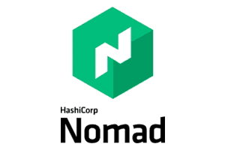
Container and Orchestration Technologies
Nomad
A simple and flexible scheduler and workload orchestrator to deploy and manage containers and non-containerized applications across on-prem and clouds at scale.
For more information
https://www.nomadproject.io/

Slide 25
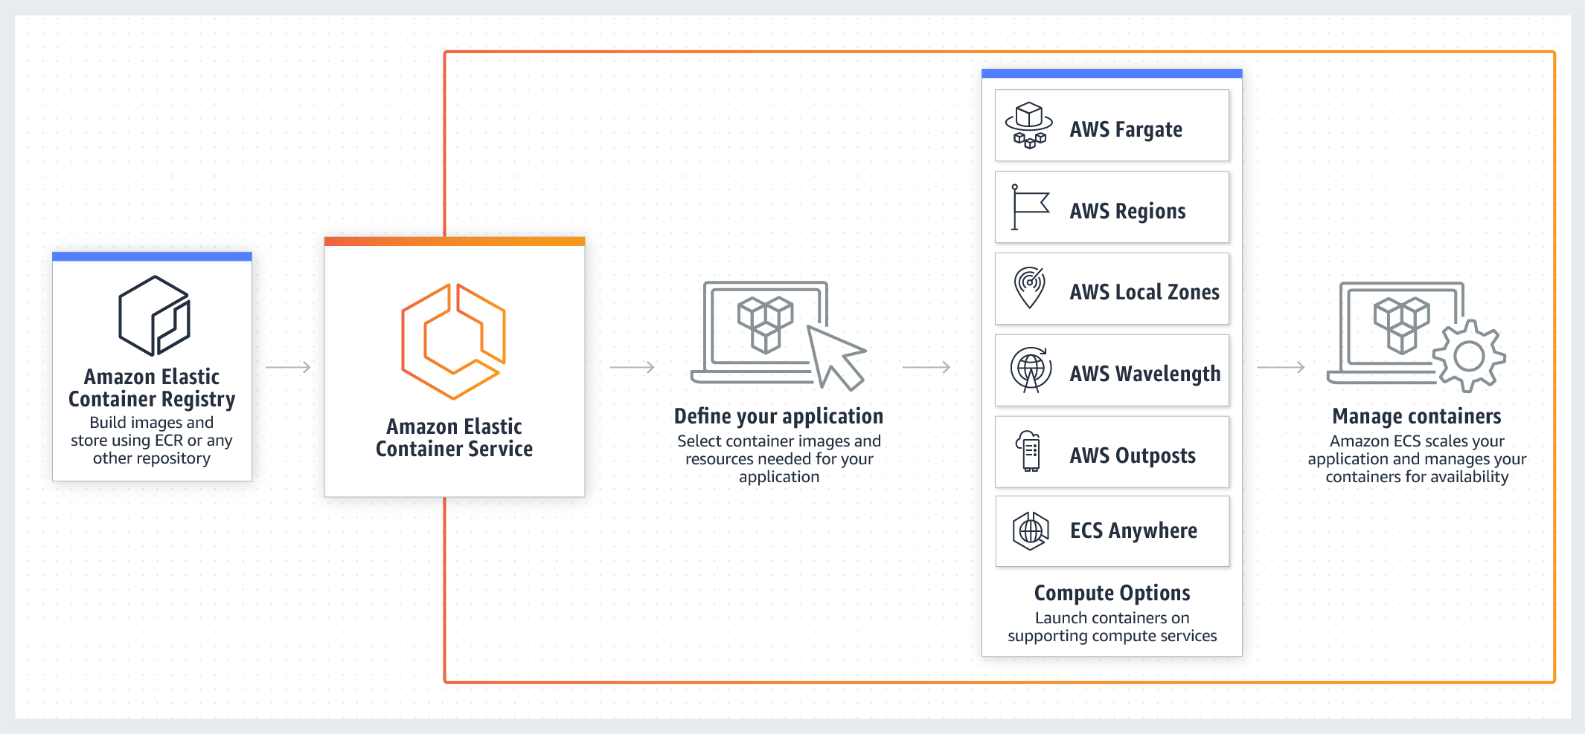

Container and Orchestration Technologies
Amazon Elastic Search
Amazon ECS is a fully managed container orchestration service that makes it easy for you to deploy, manage, and scale containerized applications.
For more information
https://aws.amazon.com/ecs/

Slide 26
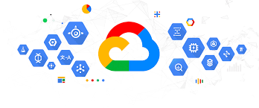
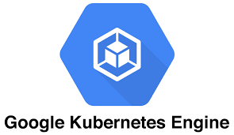
Container and Orchestration Technologies
Google Kubernetes Service
Google Kubernetes Service is a fully managed container orchestration service that makes it easy for you to deploy, manage, and scale containerized applications.
Furthermore, It has two option Standard and Autopilot.
Autopilot, fully managed solution that manages your entire cluster’s infrastructure without worrying about configuring and monitoring. And with per-pod billing, Autopilot ensures you pay only for your running pods, not system components, operating system overhead, or unallocated capacity.
For more information
https://cloud.google.com/kubernetes-engine

Slide 27
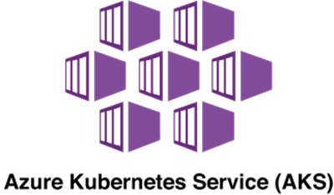
Container and Orchestration Technologies
Azure Kubernetes Service (AKS)
Deploy and manage containerized applications more easily with a fully managed Kubernetes service. Azure Kubernetes Service (AKS) offers serverless Kubernetes, an integrated continuous integration and continuous delivery (CI/CD) experience, and enterprise-grade security and governance. Unite your development and operations teams on a single platform to rapidly build, deliver, and scale applications with confidence.
For more information
https://azure.microsoft.com/en-us/services/kubernetes-service

Slide 28
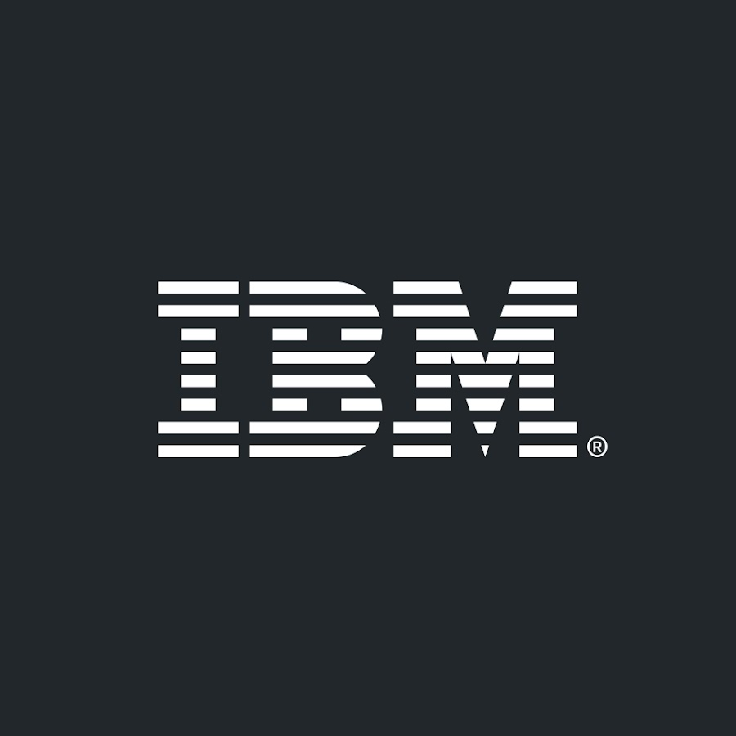
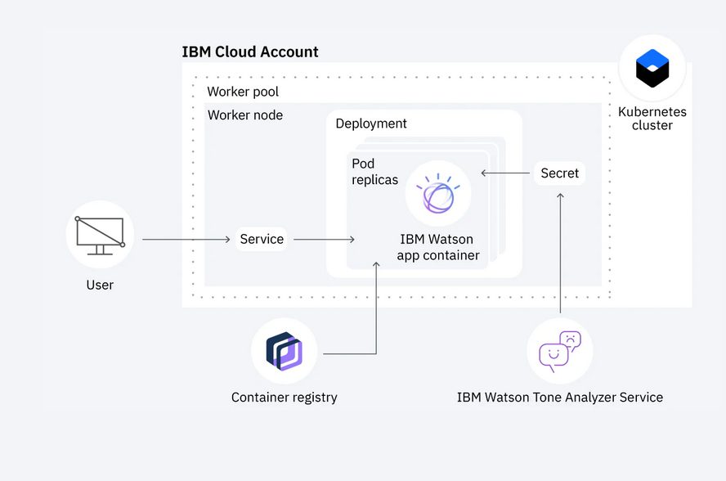
Container and Orchestration Technologies
IBM Kubernetes Engine
Offers, creating Kubernetes service, Deploy a scalable web app, Analyze logs, monitor apps, and Deploys apps continuously.

Slide 29
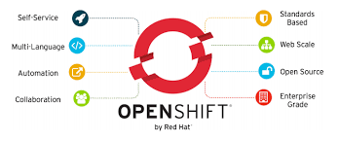
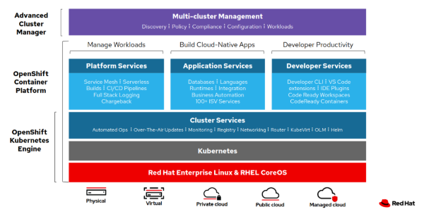
Container and Orchestration Technologies
RedHat OpenShift
Red Hat OpenShift is a leading enterprise Kubernetes platform that enables a cloud-like experience everywhere it's deployed. Whether it’s in the cloud, on-premise or at the edge, Red Hat OpenShift gives you the ability to choose where you build, deploy, and run applications through a consistent experience. Red Hat OpenShift’s full-stack automated operations and self-service provisioning for developers lets teams work together more efficiently to move ideas from development to production.
For more information
https://www.redhat.com/en/technologies/cloud-computing/openshift

Slide 30
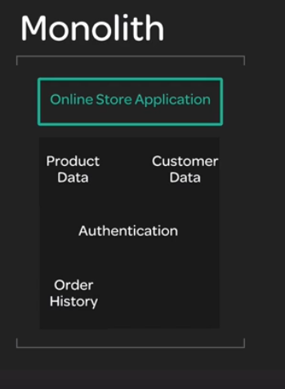
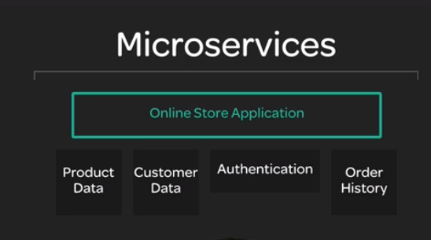
Use Cases
1. Microservices
Microservices are a type of application architecture that involves splitting the application into a series of small, independent services
Microservices can be built modified, and scaled separately with relatively little impact on one another
Containers excel when it becomes to managing many small, independent workloads
Containers and orchestration make it easier to manage and automate the process of deploying, scaling and connecting lots of microservices instances
For instance, one microservice that needs additional resources. With containers, all is creating more containers for that service to handle load. With orchestration, that can be done automatically and it real time.

Slide 31
Use Cases
2. Cloud Transformation
Cloud transformation is the process of migrating your existing IT infrastructure to the cloud
Most of the companies are moved or making the transition away from locally-hosted services and toward services hosted in the cloud.
Containers can help for moving to cloud from locally-hosted services. It is relatively easy to wrap existing software in containers. While containers may not be the answer for type of existing software, they are just powerful tools
Using containers in the cloud to run your software can allow you to take advantage of the flexibility and automatability of containers
Since containers use fewer resources than VMs, It allows to save money and time
Some examples roadmaps ,company reports, and guide for cloud transformation
https://www.trianz.com/insights/cloud-transformation-from-strategy-to-execution
https://www.virtana.com/blog/cloud-transformation/
https://de.nttdata.com/files/2020-en-wp-cloud-transformation-roadmap.pdf
https://www.mckinsey.com/business-functions/mckinsey-digital/cloud/overview/from-roadmap-to-migration-cloud-transformation-in-6-months
https://services.global.ntt/en-us/insights/blog/the-roadmap-to-your-secure-cloud-transformation-journey
https://cloud.netapp.com/blog/azure-anf-blg-the-complete-guide-to-cloud-transformation
https://www.ibm.com/garage/method/practices/culture/get-started-cloud-transformation/

Slide 32
Use Cases
3. Automated Scaling
Automated scaling refers to automatically provisioning resources in response to real-time data metrics
Without automated scaling it must be done provision enough resources to always cover your peak resource need
If It needs 10 servers to handle the peak usage time, then it always uses 10 servers when it does not need.
With automated scaling, It can be automatically detected or even predict increase in usage. The automated system creates new servers to handle the peak usage time, then remove those servers when usage returns to normal levels.
Automated scaling depends on the ability to spin up new instances quickly and efficiently
Since containers are small and can start up quickly, they are ideal for this purpose. This means that if the system detects an increasing in usage, It can spin up new containers in a few seconds.
This increases stability and reduces cost! Users face less downtime due to high loads, and it does not cost resources necessarily

Slide 33
Use Cases
4. Continuous Deployment Pipelines
Continuous deployment is the practice of deploying new code automatically and frequently.
Instead of writing new code for months and doing a big deployment, continuous deployment means constantly doing many small deployments. Some companies even do deployments a day!
This allows to get new functionality in front if customers faster, and it also reduces the risk with big deployments containing numerous changes
Maintaining stability while doing continuous deployments, It is important to make use of automation to ensure that deployments are stable and consistent
Containers are ideal tools for continuous deployment
Containers make it easy to test code in an environment that is same as production due to the code can be automatically tested inside the container itself
An automation pipeline for continuous deployment can be automatically build a container image with the new code, then automatically ship that same image production because the production environment (the containers) is built right into this automated process, developers even can use it for testing and troubleshooting

Slide 34
Use Cases
4. Self-Healing Application
Self-healing applications are be able to automatically detect when something is broken and automatically take steps to correct the problem without the need for human involvement
System administrators will tell mostly, in the past , it was common to have to wake up in the middle of the night to reboot a server
An automated system will reboot a server when it needed it is such an excellent application for self-healing application or automated scaling
Since containers starts up quickly, it is very easy enough to automatically restart them
However, Containers take the concept of rebooting the server a step further. Since it so quick and easy to start up new containers instances it can often be easily destroyed and replaced within few seconds. That means if something goes wrong It has ability to destroy and rebuild a new container. It brands new, clean, working instance quickly replace broken one

Slide 35
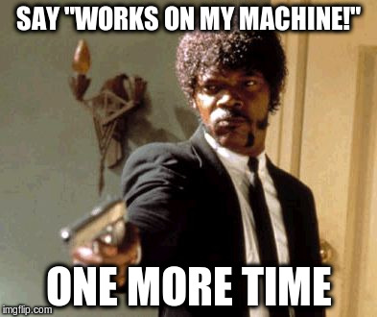
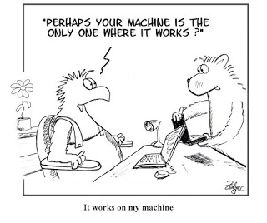
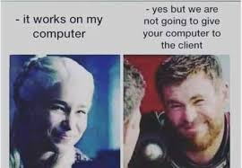
Use Cases
6. Developer Visibility
In more traditional environments, It can be difficult for everyone to get access to a production system troubleshoot when something goes wrong. That may be due to security policy, concerns etc. When a problem happened the first priority is fixed it not to find the problem. Anyone in the organization that does not have direct access to a production system has no idea why code may or may not be working in production. This leads to the constant refrain, “Well, It works on my machine”
With containers, the containers is the production environment. This means that anyone can spin up an environment that is exactly like production, even their PC. Developers and Operation teams have the ability to test the code and find out the bugs
That is why visibility offered by containers can help an organization develop and troubleshoot code much more efficiently!

Slide 36
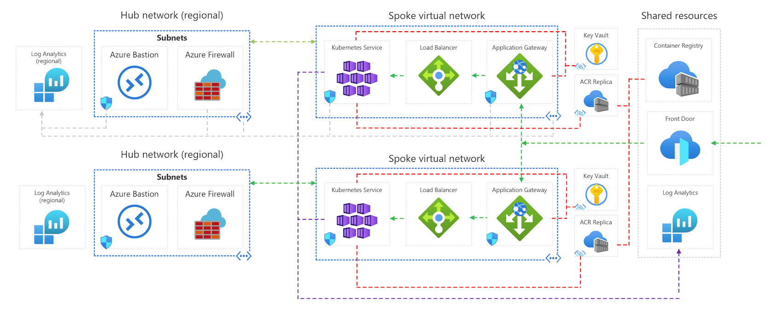
Advanced Topics
Multi-Region Deployment
AKS baseline for multiregion clusters
This scenario taken from AKS baseline architecture
https://docs.microsoft.com/en-us/azure/architecture/reference-architectures/containers/aks/secure-baseline-aks

Slide 37
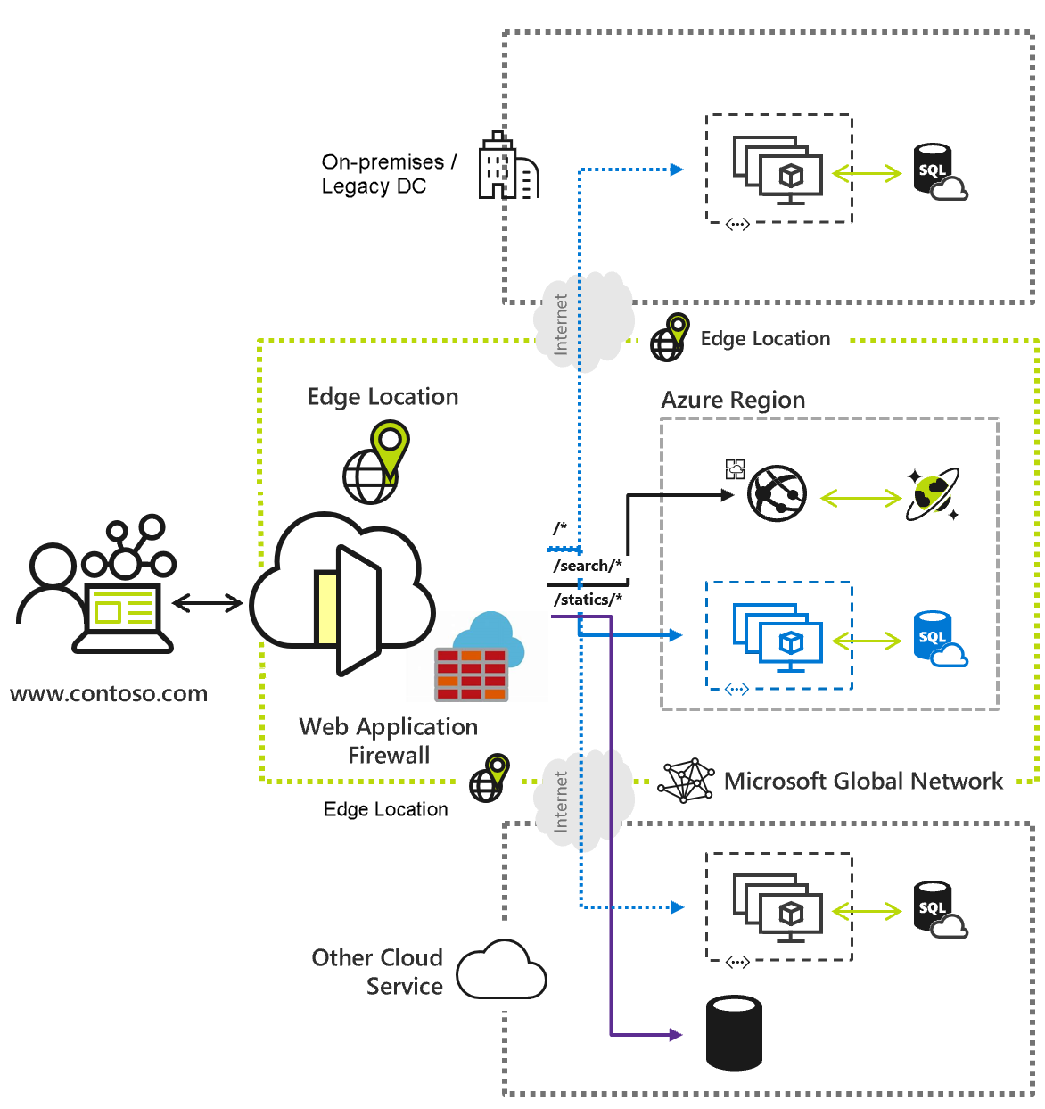
Advanced Topics
Multi-Region Deployment
AKS baseline for multiregion clusters
Azure Front Door
With this Front Door you can build, run and scale your dynamic web applications and static content. Front Door allows you to define, manage and monitor the global routing for your web traffic using improvements for top-tier end-user performance and reliability through fast global failover.
A builded example for multiregion AKS-baseline architecture on GitHub
https://github.com/mspnp/aks-baseline-multi-region

Slide 38
Advanced Topics
Multi-Region Deployment
AKS baseline for multiregion clusters
For more information and Examples
https://www.redhat.com/architect/multi-cluster-kubernetes-architecture
https://octopus.com/docs/deployments/patterns/multi-region-deployment-pattern
https://aws.amazon.com/solutions/implementations/multi-region-application-architecture/
https://curity.io/resources/learn/multi-region-deployment/
https://aws.amazon.com/solutions/implementations/multi-region-infrastructure-deployment/

Slide 39
Resources and References
Essential Container Concept
https://learn.acloud.guru/course/03155237-268d-4c80-b704-af2fbe5bdcdb/dashboard
Beginners guide to Containers and Orchestration
https://learn.acloud.guru/course/f276f2aa-fb5e-4fc6-9c36-0dc674b95767/dashboard
Docker Deep Dive Nigel Poulton Part 1 chapter 1
https://www.ibm.com/cloud/learn/container-orchestration
https://github.com/prasenforu/container-platform

